Slide 1
Control of Computer Mouse Using Hand Movement Detection in Motion Pictures
کنترل ماوس کامپیوتر با تشخیص حرکت دست در تصویر
Yalda Foroutan
Supervisors:
Dr. Ahmad Kalhor
Dr. Samad Sheikhaei

Slide 2
01
Introduction
02
Related Works
03
Proposed Algorithm
04
Results and Evaluations
05
Conclusion
Contents
2/38

Slide 3
Human-computer Interaction
Introduction
Hand Gesture Recognition
Hand Shape, Palm, and Fingers
Without a Single Contact
Using a Camera

Slide 4


Project Objectives
Introduction
Hand Gestures Dataset
CNN
Classifier
Similarity Network
Controller Unit
Turn on or off
Click and Right-click
Move

Slide 5
Computer Mouse Evolution
Related Works
Improving the Mouse
Mechanical, Optical, and Laser
Wired, and Bluetooth
2D, and 3D Movements
Removing the Mouse Using …
Kinect Sensor
EEG Signals
EMS Signals

Slide 6
Hand Gesture Recognition
Related Works
Hand Detection in Frame
Hand Gesture Classification
Command Allocation

Slide 7
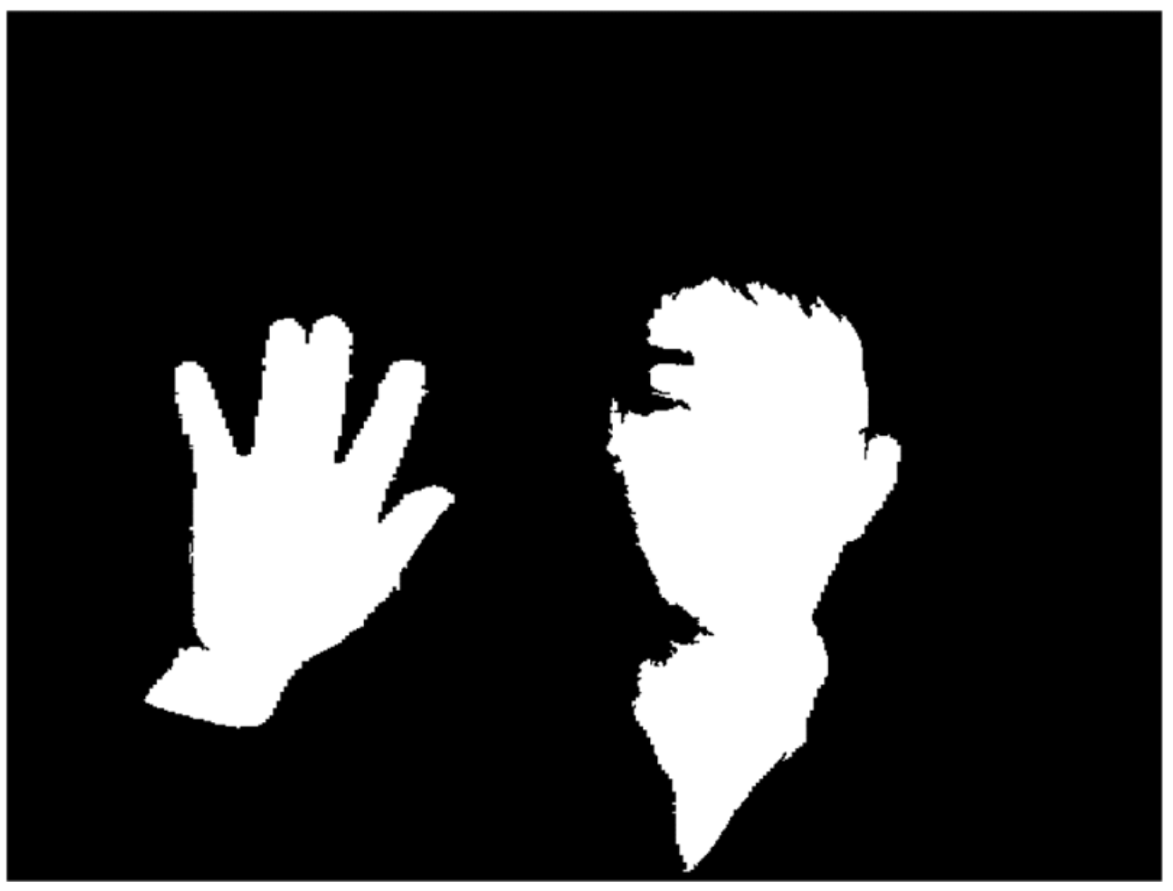
Hand Gesture Recognition – Article 1
Related Works
Skin Color Detection from Video
Preprocessing
Hand Region Segmentation
Gesture Recognition
[Huang, H. (2019). Hand gesture recognition with skin detection and deep learning method. In Journal of Physics: Conference Series.]

Slide 8
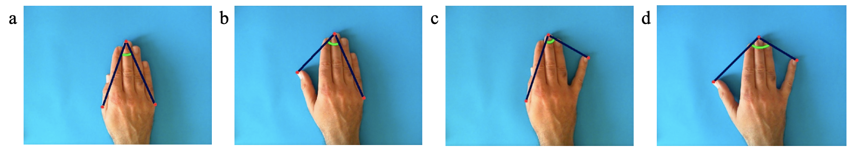
Hand Gesture Recognition – Article 2
Related Works
Camera, Tripod, Hand Pad (Blue paper)
HSV Color Space
Background Subtraction
A Hand Angle Feature
[Grif, H. S. (2018). Human hand gesture based system for mouse cursor control. Procedia Manufacturing.]

Slide 9
Hand Gesture Recognition – Article 3
Related Works
Light YOLOv2
Taylor Expansion
Selective Dropout
[Ni, Z. (2018). Light YOLO for high-speed gesture recognition. In 2018 25th IEEE International Conference on Image Processing.]

Slide 10
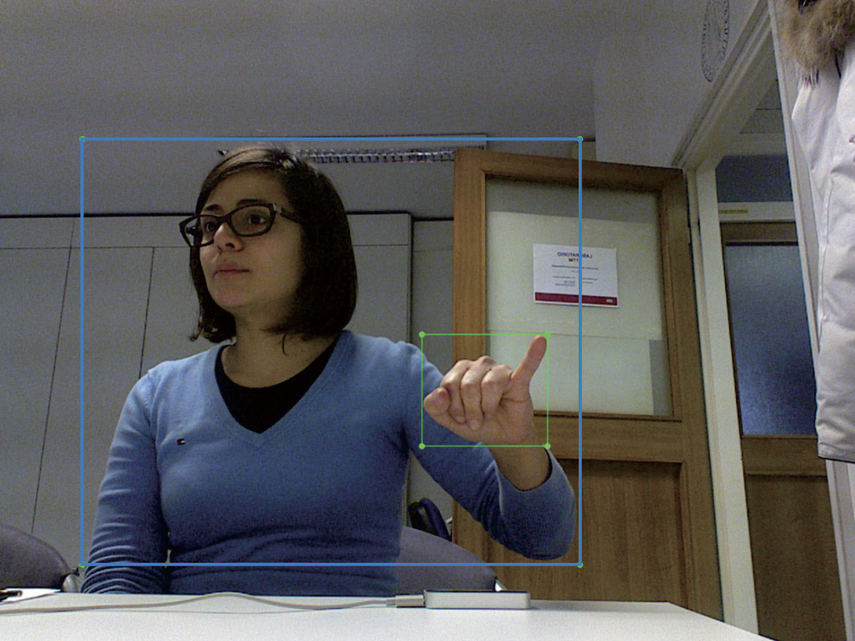
Hand Gesture Recognition – Article 4
Related Works
Joint SSD
Head-shoulder Detection
Trigger Layer
Hand Detection
[Yi, C. (2018). Long-range hand gesture recognition with joint SSD network. In 2018 IEEE International Conference on Robotics and Biomimetics.]

Slide 11
Conclusion
Related Works
Appearance Approaches
Easy
High Speed
Dependency on Skin Color
Low Accuracy
Neural Network Approaches
More Generalization
More Accurate
Needing Big Datasets
Low Speed
Proposed Mouse

Slide 12
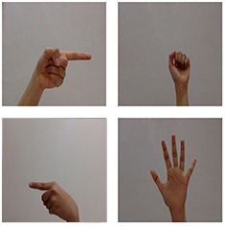
Hand Dataset
Proposed Algorithm
6720 RGB Images
4 Classes
Fist
Palm
Right
Left
15 Persons
Different Simple Backgrounds
Two Distributions
Training Set: 5120 Samples
Validation Set: 1600 Samples

Slide 13
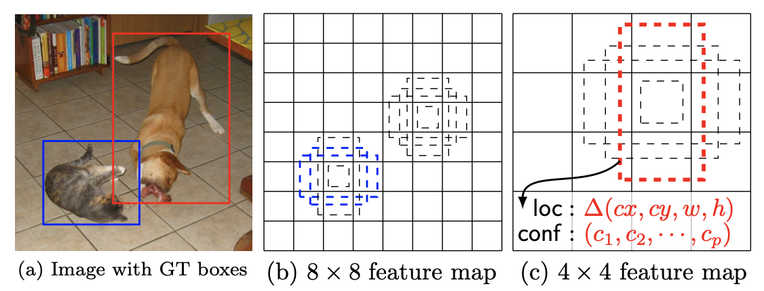
Object Detection in NN
Proposed Algorithm
Object Detection
Two-stage
R-CNN
One-stage
SSD (Single-shot Detector)

Slide 14
Hand Detection: SSD
Proposed Algorithm
Input: A Frame from Webcam
Outputs:
Cropped Frame
Center Coordination of the Cropped Frame

Slide 15
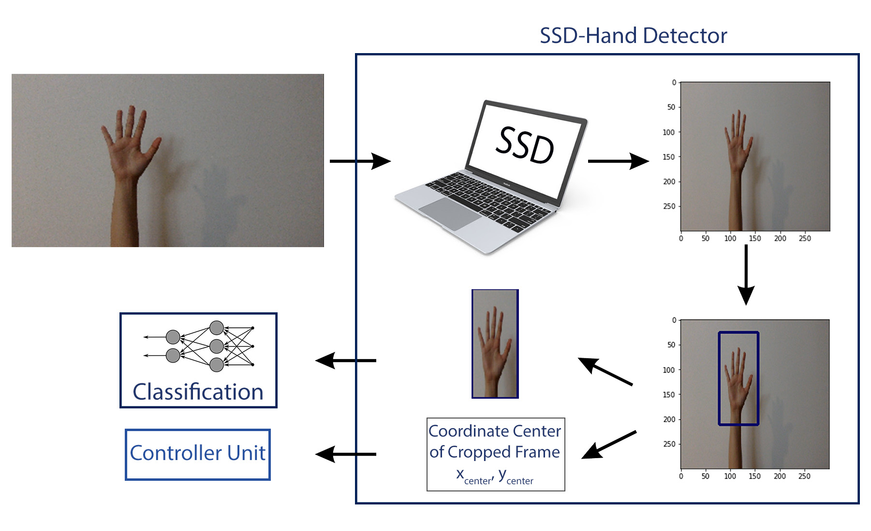
Hand Detection: SSD
Proposed Algorithm

Slide 16
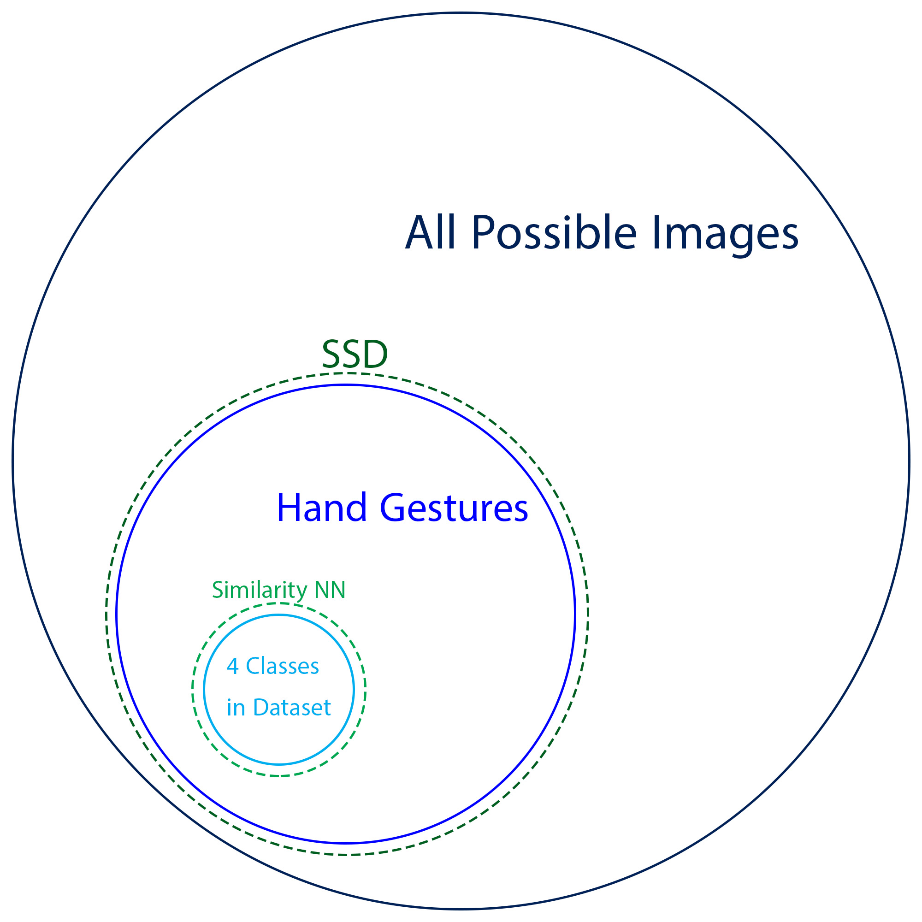
Classification
Proposed Algorithm
Classifier
Similarity Network

Slide 17
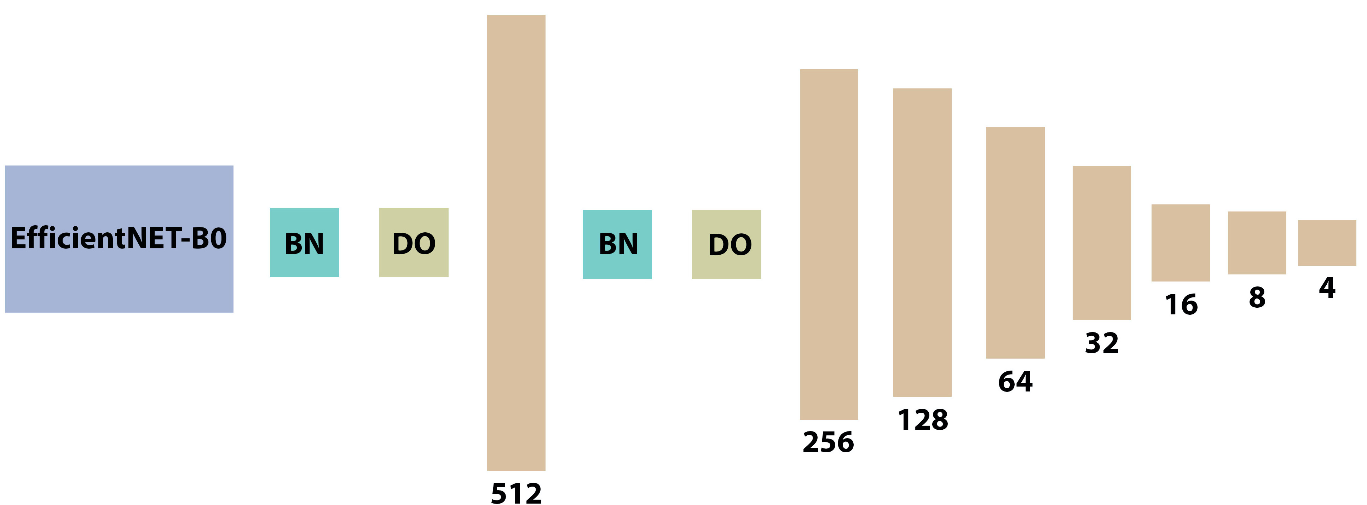
Classification
Proposed Algorithm
Transfer Learning: EfficientNet-B0
Scaling all Dimensions of Depth, Width, and Resolution
Fully-connected Layers
Hand Dataset 6720
Training Set: 5120 Samples
Validation Set: 800 Samples
Test Set: 800 Samples

Slide 18
Classification: Classifier
Proposed Algorithm
Dataset
5120 Training and 800 Validation Samples
70*70*3
EfficientNet-B0, 8 Fully-Connected Layers
4.8 M Parameters
Adam Optimizer with LR=0.0001
Categorical Cross Entropy
20 Epochs

Slide 19
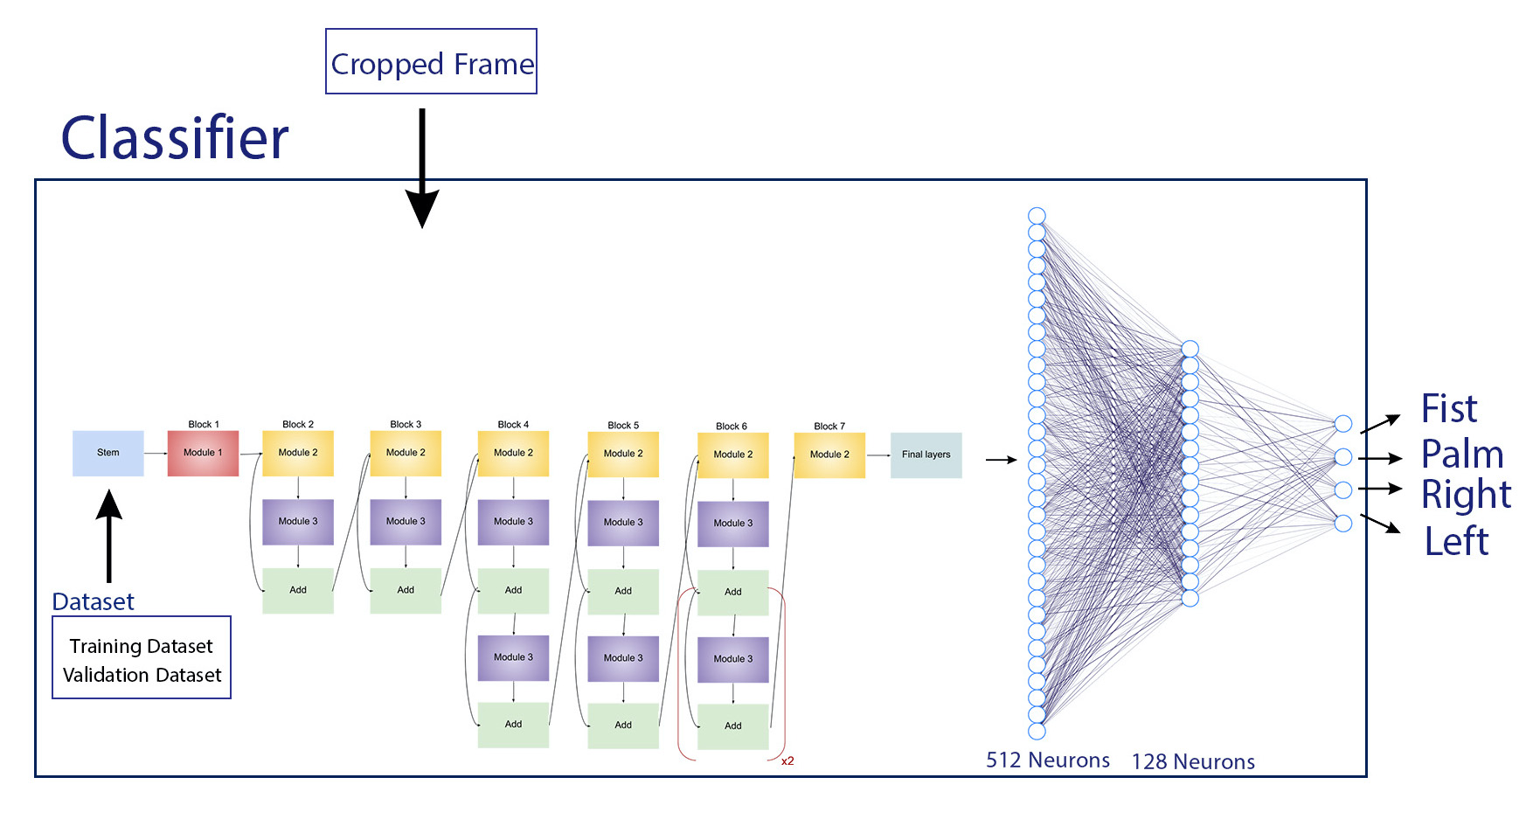
Classification: Classifier
Proposed Algorithm

Slide 20
Classification: Similarity NN
Proposed Algorithm
Removing Fully-connected Layers
Saving EfficientNet-B0 Part
All Dataset Samples thorough Similarity NN
Creating 4 Reference Vectors
Setting 4 Thresholds

Slide 21
Classification: Similarity NN
Proposed Algorithm
Validation Set
Class | Maximum Euclidean Distance
Fist | 34.9
Palm | 34.29
Right | 45.5
Left | 48

Slide 22
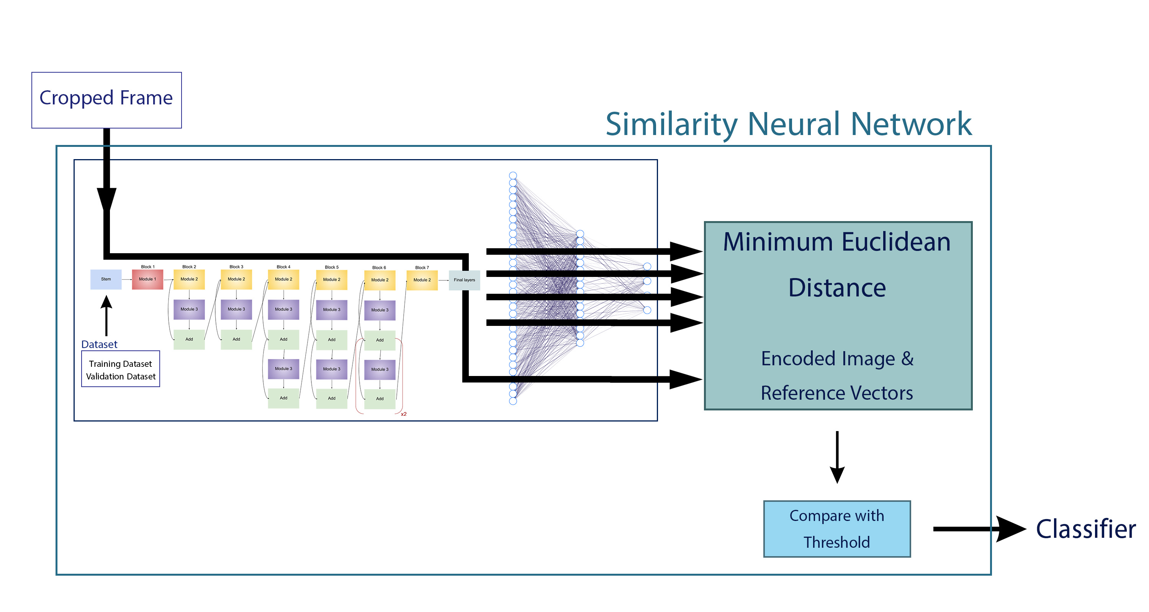
Classification: Similarity NN
Proposed Algorithm

Slide 23
Controller Unit
Proposed Algorithm
Palm: Turning on, Moving the Cursor
Left: Clicking
Right: Right-clicking
Fist: Turning off

Slide 24
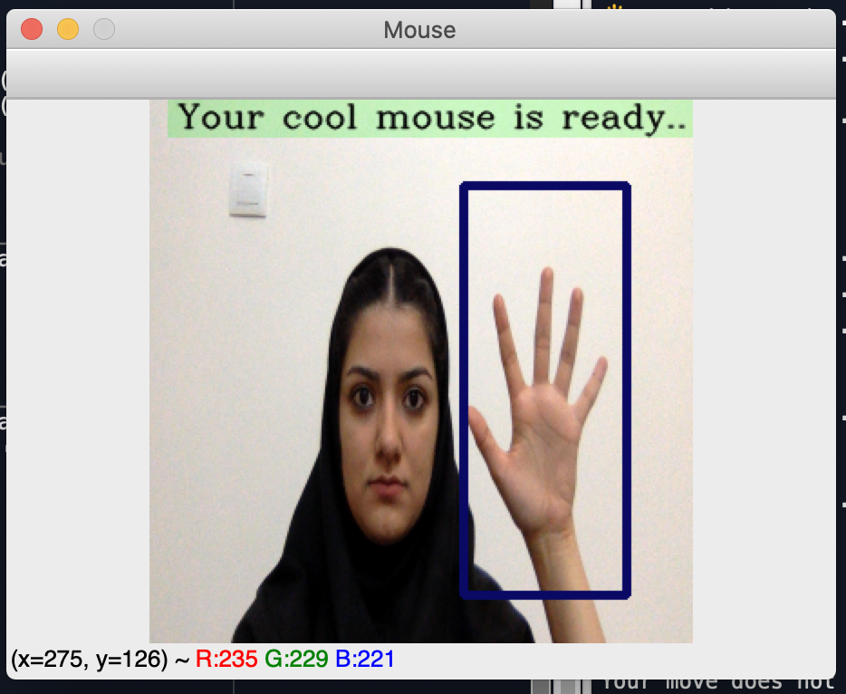
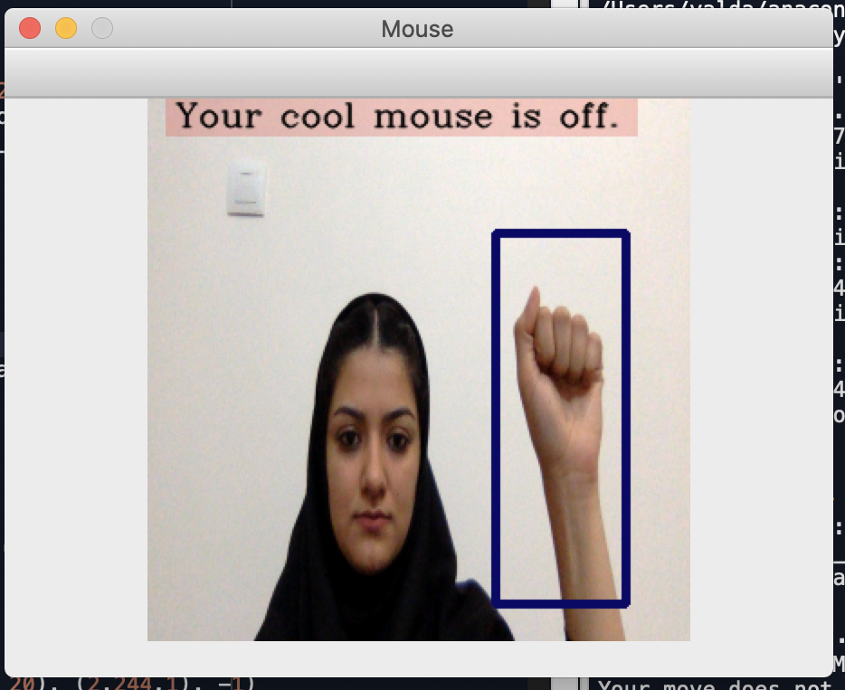
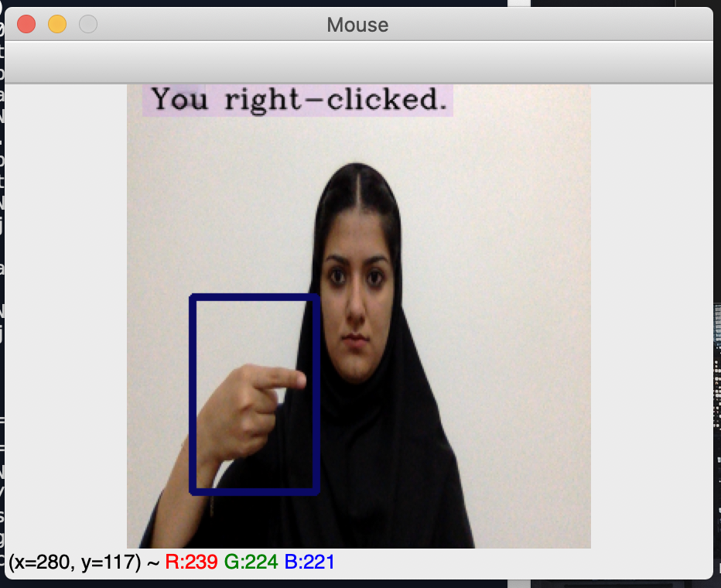
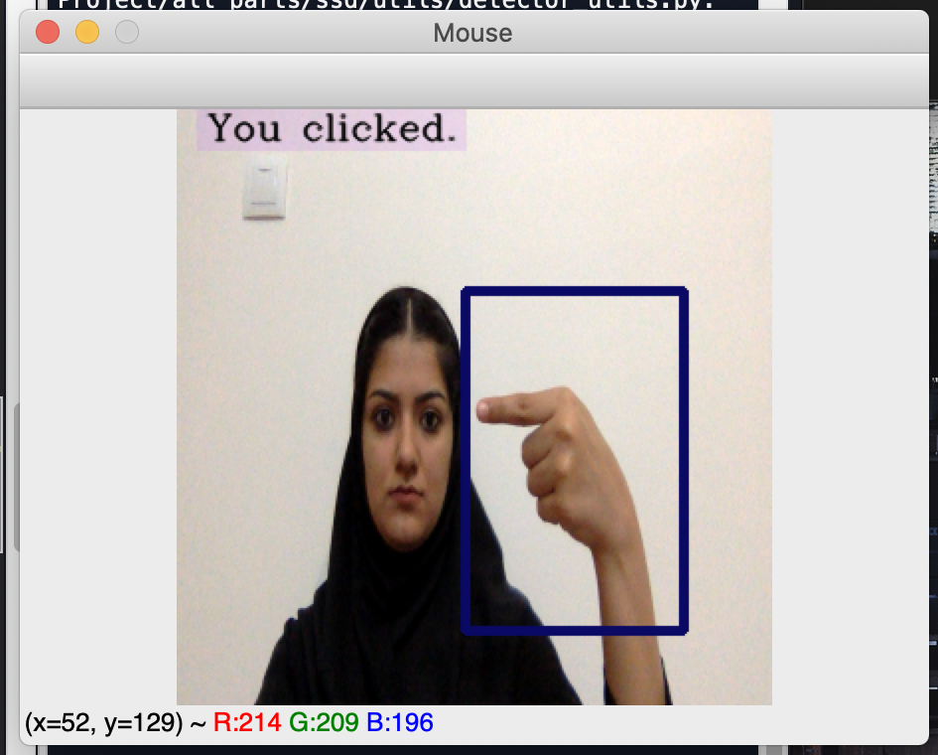
Controller Unit
Proposed Algorithm

Slide 25
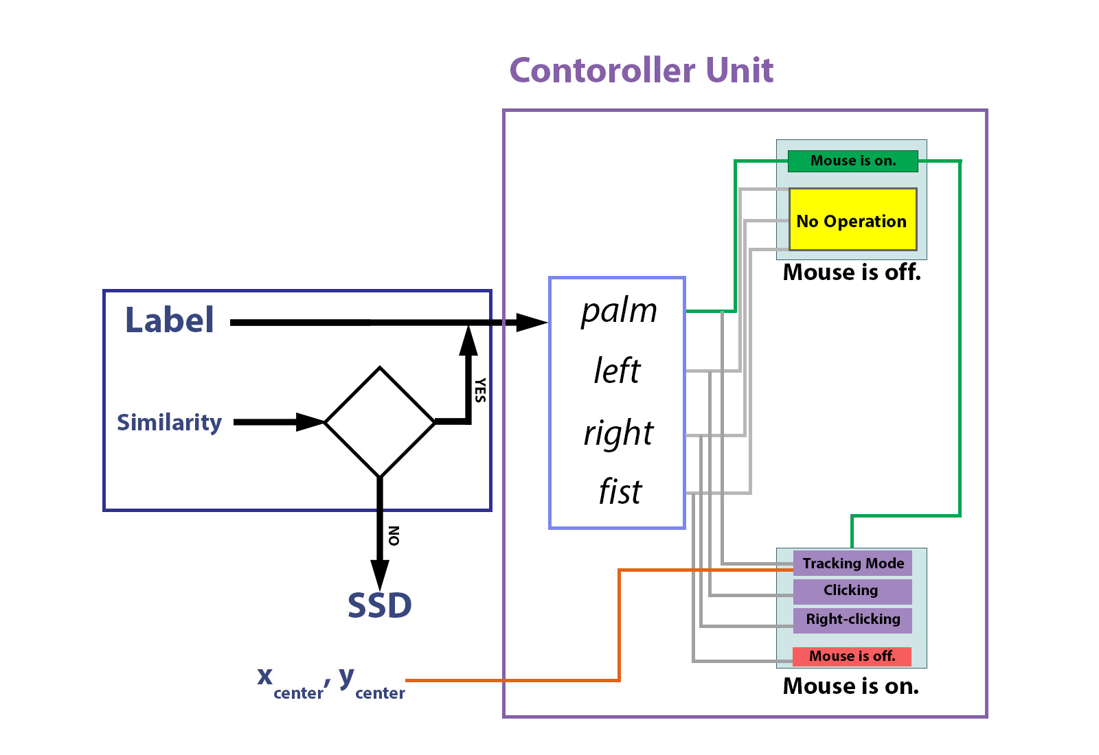
Controller Unit
Proposed Algorithm

Slide 26
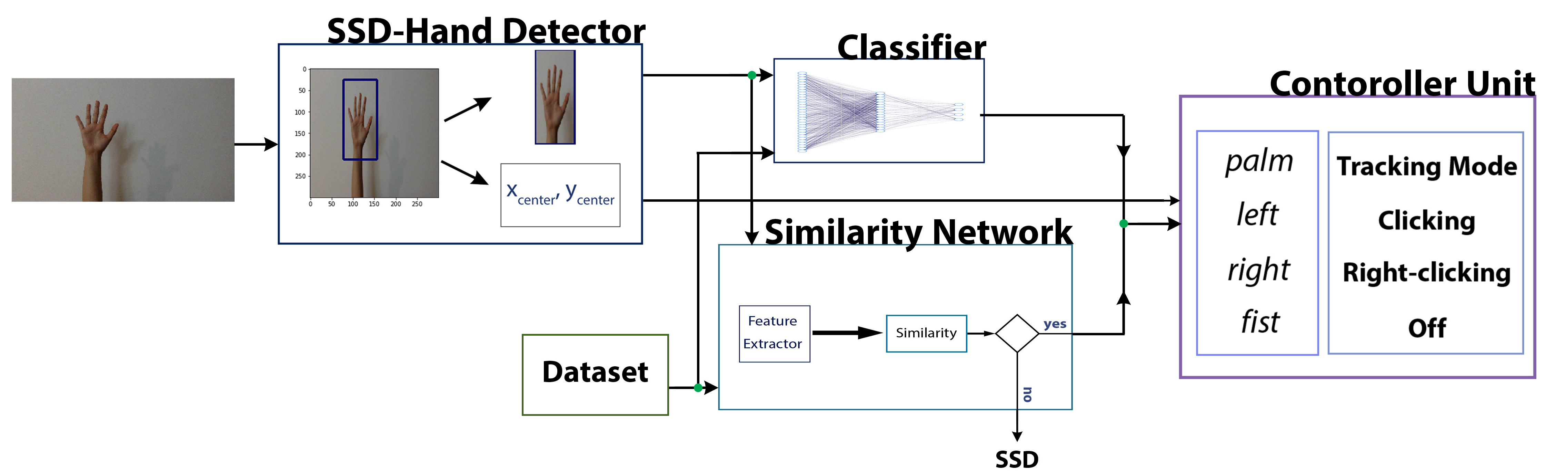
Mouse
Proposed Algorithm

Slide 27
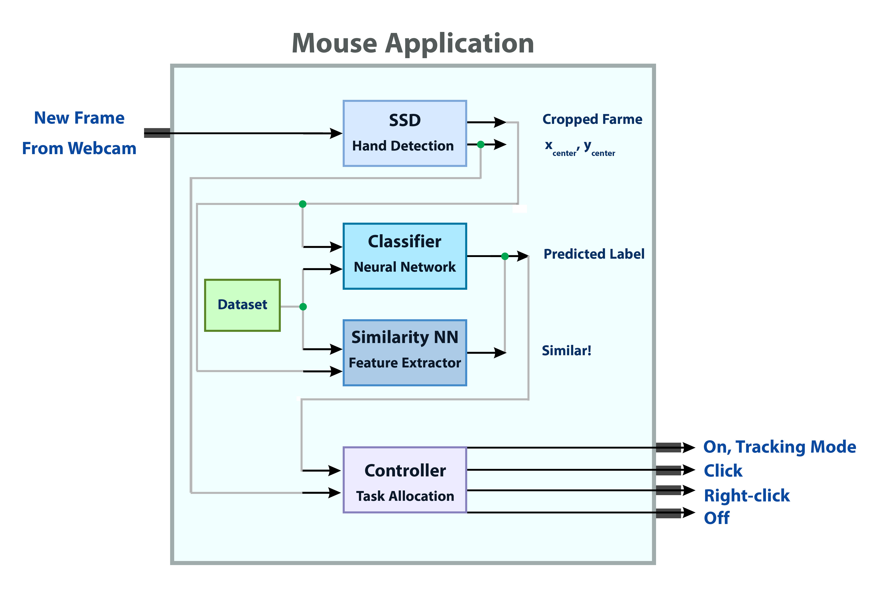
Mouse
Proposed Algorithm

Slide 28
Delay of Proposed Mouse
Results and Evaluations
GPU: GTX 1080
Delay = f(detector(H), classifier(H))
SSD
Nvidia Titan X: 58 fps
GTX 1080: 20 fps
Proposed Mouse
GTX 1080: 15 fps
Intel Iris Plus Graphics 640: 5 fps

Slide 29
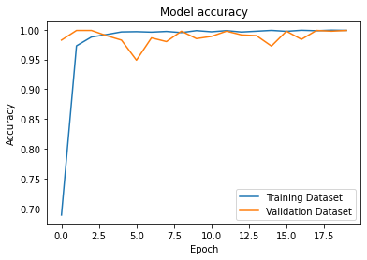
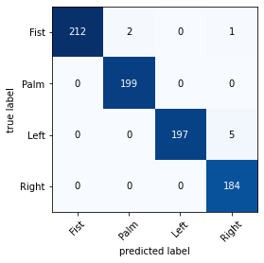
Classifier
Results and Evaluations
Test Set: 99% Accuracy

Slide 30
Classifier
Results and Evaluations
Network | Test Set Accuracy | Number of Parameters | Needed Time
EfficientNet-B0 | 99% | 4.98M | 671us/step
VGG16 | 100% | 15.95M | 776us/step

Slide 31
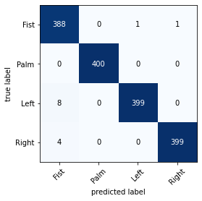
Similarity NN
Results and Evaluations
Validation Set: 99.12% Accuracy

Slide 32
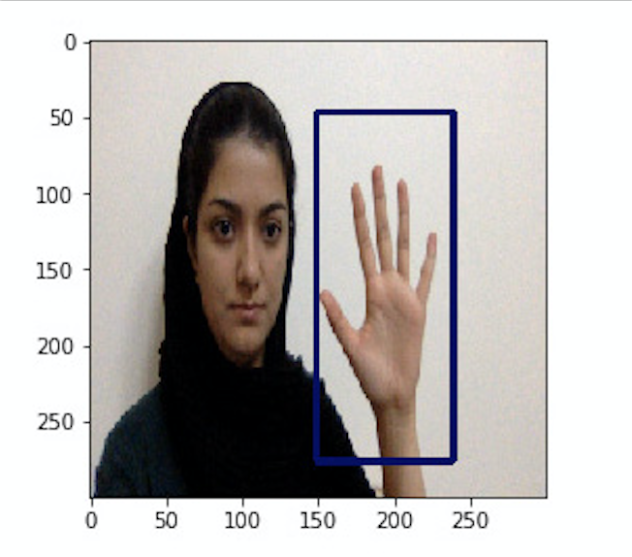
Proposed Mouse
Results and Evaluations
White Background | First Light Condition (brighter) |  |  |  | Second Light Condition (darker)
Hand | Right Hand |  | Left Hand |  | Right Hand |  | Left Hand
Distance | Near | Far | Near | Far | Near | Far | Near | Far
Off | 10 | 10 | 10 | 10 | 10 | 10 | 9 | 10
On, Moving | 10 | 10 | 10 | 10 | 10 | 10 | 10 | 10
Click | 10 | 10 | 10 | 10 | 10 | 10 | 10 | 10
Right-click | 7 | 9 | 8 | 10 | 9 | 10 | 10 | 8

Slide 33
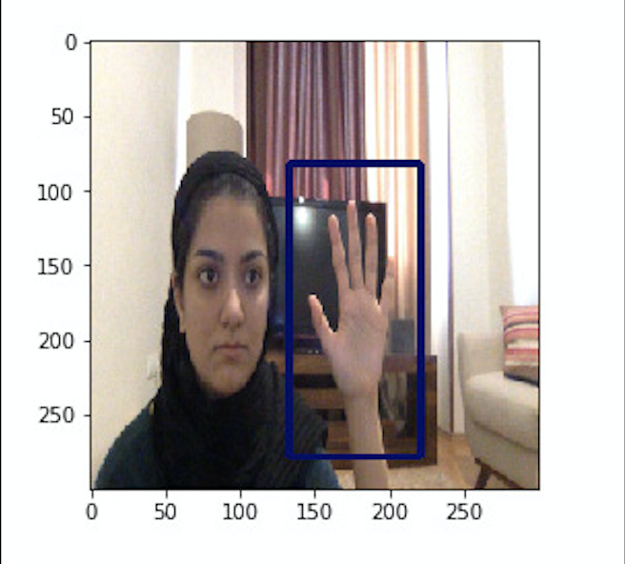
Proposed Mouse
Results and Evaluations
Simple Background | First Light Condition (brighter) |  |  |  | Second Light Condition (darker)
Hand | Right Hand |  | Left Hand |  | Right Hand |  | Left Hand
Distance | Near | Far | Near | Far | Near | Far | Near | Far
Off | 9 | 10 | 10 | 10 | 10 | 8 | 10 | 10
On, Moving | 10 | 10 | 9 | 10 | 10 | 10 | 10 | 10
Click | 10 | 10 | 10 | 10 | 10 | 10 | 10 | 10
Right-click | 10 | 10 | 10 | 10 | 9 | 10 | 9 | 10

Slide 34
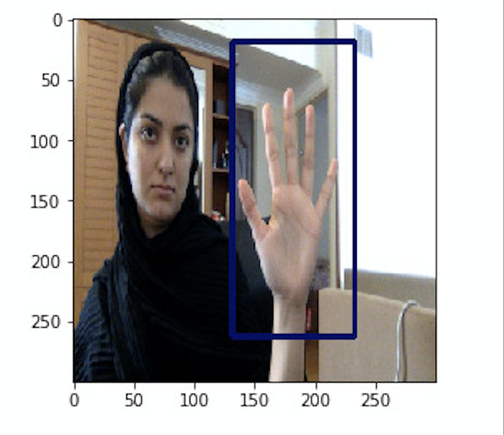
Proposed Mouse
Results and Evaluations
Complex Background | First Light Condition (brighter) |  |  |  | Second Light Condition (darker)
Hand | Right Hand |  | Left Hand |  | Right Hand |  | Left Hand
Distance | Near | Far | Near | Far | Near | Far | Near | Far
Off | 10 | 10 | 9 | 7 | 10 | 9 | 5 | 3
On, Moving | 10 | 10 | 8 | 6 | 10 | 10 | 10 | 10
Click | 10 | 10 | 3 | 2 | 10 | 1 | 9 | 9
Right-click | 10 | 9 | 10 | 10 | 8 | 7 | 10 | 10

Slide 35
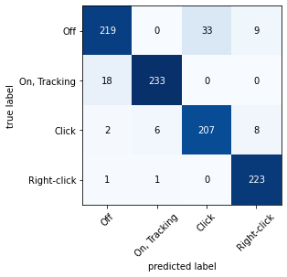
Proposed Mouse
Results and Evaluations

Slide 36
Proposed Mouse
Results and Evaluations
 | White Background | Simple Background | Complex Background | All
Off | 98.75% | 96.25% | 78.75% | 91.25%
On, Moving | 100% | 98.75% | 92.5% | 97.08%
Click | 100% | 100% | 67.5% | 89.17%
Right-click | 88.75% | 97.5% | 92.5% | 92.92%
All | 96.88% | 98.13% | 82.81% | 92.6%

Slide 37
Proposed Mouse
Conclusion
Features
Hand Dataset
No Skin Color Dependency
Using Neural Network
Applications
Control Computer/Other Smart Systems
In Public Places
With Complex Backgrounds

Slide 38
Future Works
Conclusion
Adding Other Mouse Tasks
Using Trackers
Using Motion Detections
Using a Infrared Camera
Dataset in a Particular Background
Training the Detector

Slide 39
Thanks For Your Attention!

